Slide 1
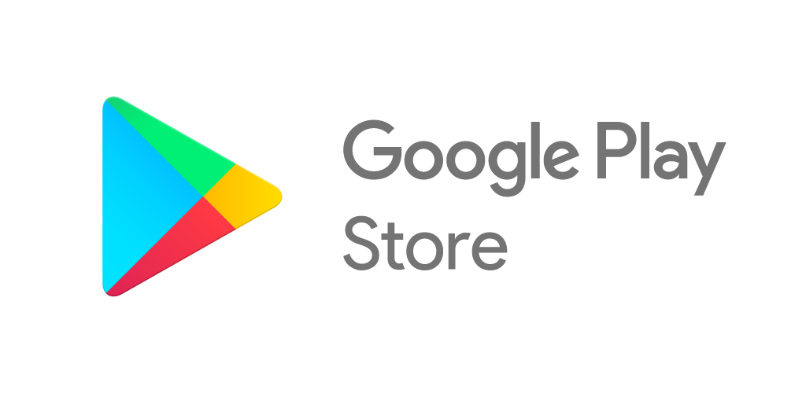
Playstore App Reviews
An Exploratory Data Analysis on
Capstone Project by team: Avengers
Members:
Sanjeev Hegde
Bishwajeet
Saad
Samruddhi

Slide 2


Table of Contents:
Need for the Analysis
Problem Statement
Introduction
Attributes in the Data
Data Cleaning and Preparation
Statistical Walkthrough for numerical data
Analysis of the Category of Apps
Category and Installs
Categories and Rating
Correlation Heatmap, Reviews and Installs
App size and Installs
App Size and Rating
Content Rating and Apps
App(s) with Highest Rating, Price and Installs
Sentiment Polarity Analysis from User Reviews
Sentiment Subjectivity Analysis from User Reviews
Sentiment Polarity, Sentiment Subjectivity and Apps
Content Rating and User Reviews

Slide 3




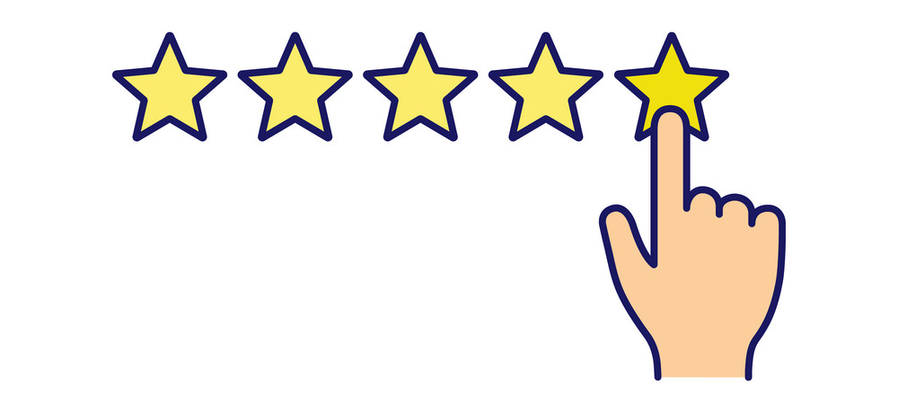
Why perform an analysis?
For analysing various parameters affecting user preference- improvising app development
For studying shortfalls in apps providing services in specific categories
For analysing the user experience from reviews
For developing appropriate revenue model and/or pricing

Slide 4


What makes a successful app?
There are numerous factors which need to be considered while developing an app in order to ensure it is successful.
Is it the Category of the App?
Does size of the App matter?
Do app reviews help in fueling the installs?
Priced or a Free App to develop?
These are some of the examples of questions that pop up in head while developing an app or while providing any service to customers through Apps on Playstore.
Let us analyze the given two Data sets and answer essential questions for better understanding the App market

Slide 5

Introduction
Google Play store is the official app store for devices which run android platform developed by Google
Developers can get their certified apps hosted on the Playstore
Applications can be either free or priced or even contain in-app purchases
As on 2017 August, about 3 million android applications are on play store
Apps include Services, Games, Books, Movies etc
Key features include:
Provide reviews and ratings for each app which are public
Sign up for beta programs
Make in-app purchases through google play balance

Slide 6
Attributes in Data
1. Play store Data (data set-1)
App: The name of the application on which the data is provided
Category: The category to which the app belongs to
Rating: User Rating for the app out of 5
Reviews: Publicly available user reviews
Size: Size of the application
Installs: Total Number of installations
Type: Free or paid
Price: Price of the application
Content Rating: To whom the application has been developed for
Genres: Genre the application belongs to
Last Updated: Last update provided the developer for the app
Current Ver: Present version of the application
Android Ver: Android version that application is supported on

Slide 7
1. User Reviews (data set-2)
App: The name of the application on which the data is provided
Translated Reviews: The translated and processed content of the user review
Sentiment: The sentiment of the user review
Sentiment Polarity: A quantitate measure of the sentiment in user’s review. Values range from -1 implying highest negative to +1 implying highest positive sentiment in the review.
Sentiment Subjectivity: A quantitative measure of the subjectiveness of the review. Values Range from 0 to +1 wherein zero implies Objective review while +1 implies highly subjective review

Slide 8

Data Cleaning and Preparation
Given data sets are cleaned and processed for exploratory data analysis. Following processes have been made:
Identification and modification of abnormal data with appropriate changes
Finding and filling null values in the data with suitable numeric values
Conversion of quantified parameters such as app size to Kilobytes
Eliminating non essential characters such as commas, +, $ etc in numeric values
Converting string values of dates to date and time format
Converting all columns to their required data type
Dropping Non essential columns such as Translated Review Parameter which has been already evaluated for Sentiment, polarity, subjectivity

Slide 9
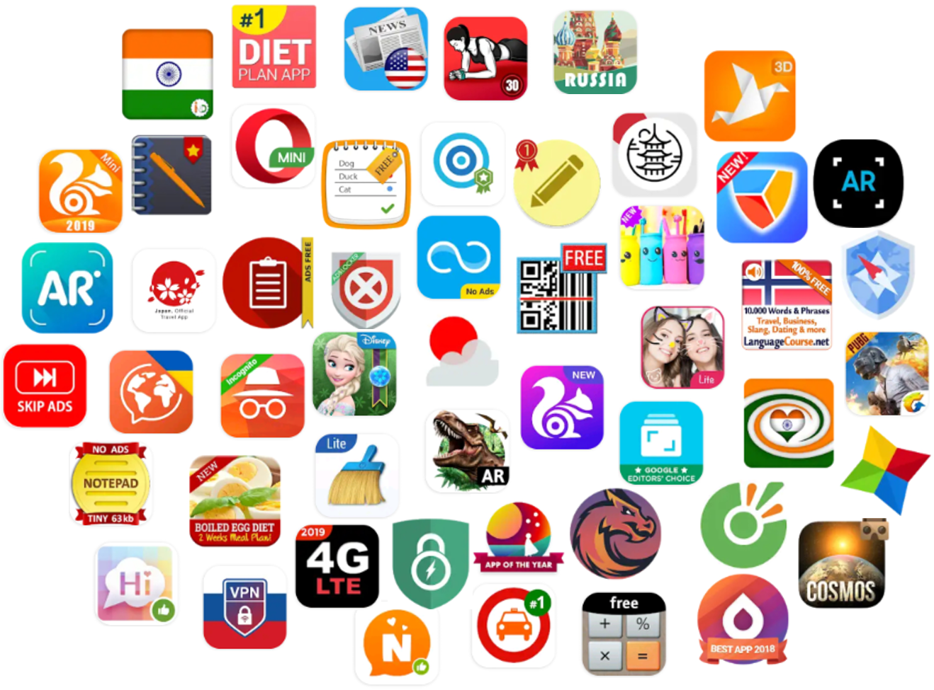

Statistical Overview:
There are 10,841 entries in the Play Store Data set
Average Rating for the apps is about 4.2 stars
Average size of app is about 16.5MB
Largest app is 100MB in size while smallest app is 1KB
Costliest app costs $400
Standard deviation for ratings from mean is about 0.48 stars

Slide 10
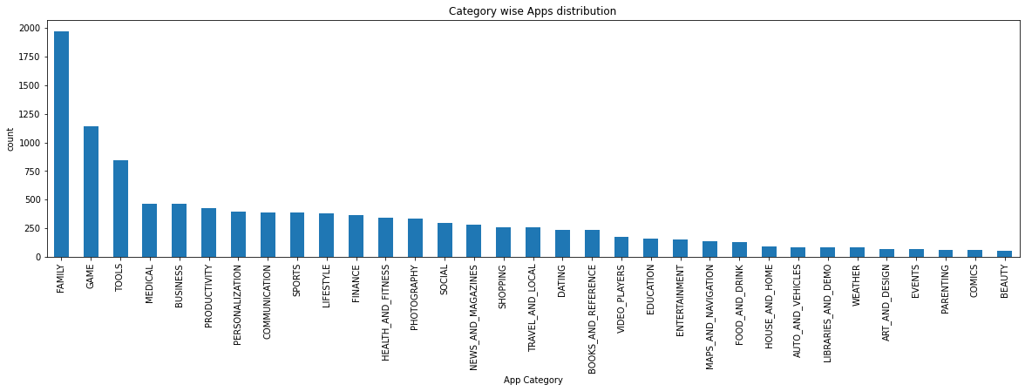
Category wise apps
It can be seen that Family category apps are present the most followed by Games and Tools categories

Slide 11
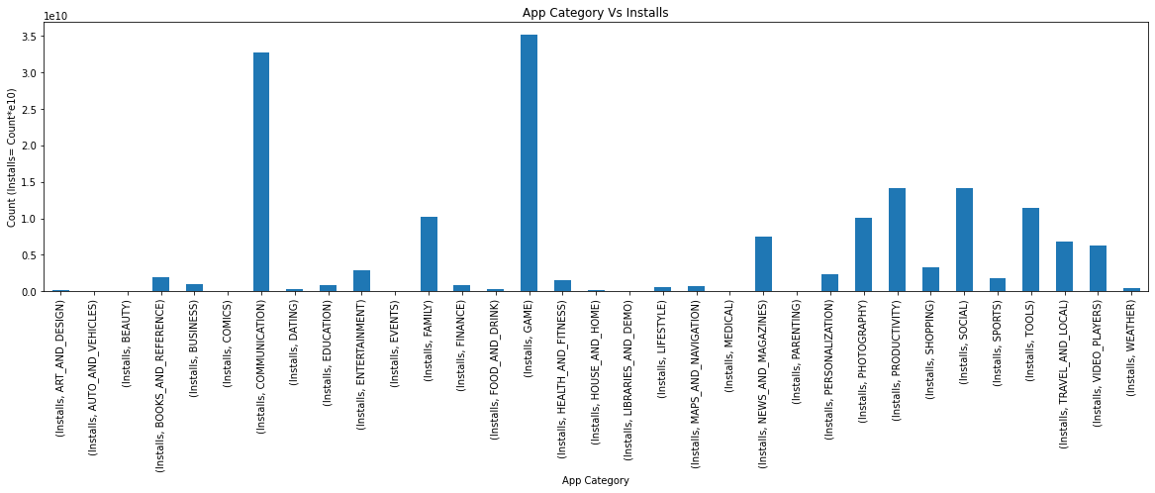
Category and Installs
It can be seen that Game category apps have highest installs followed by Communication apps

Slide 12
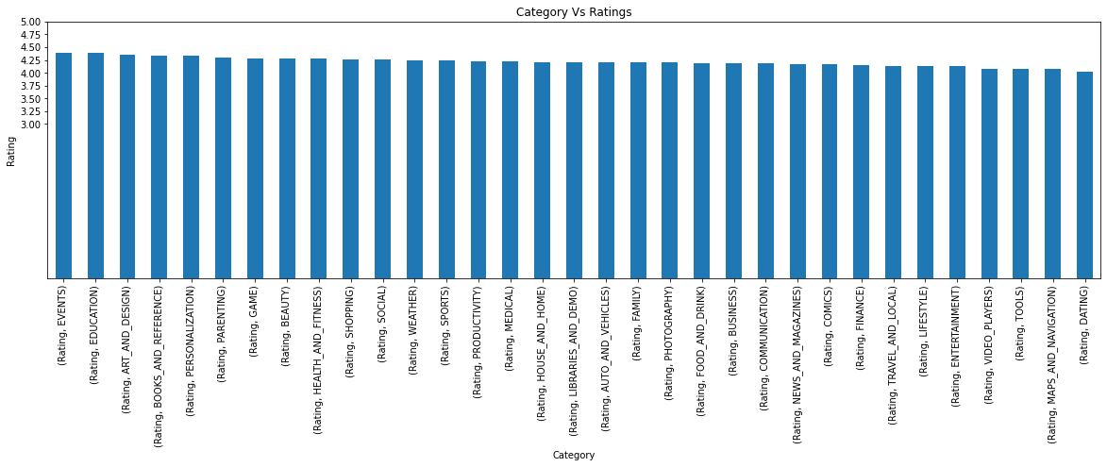
Category and Rating
It can be seen that Event category apps have highest Ratings about 4.4. All the category of apps have ratings above 4 Stars.

Slide 13
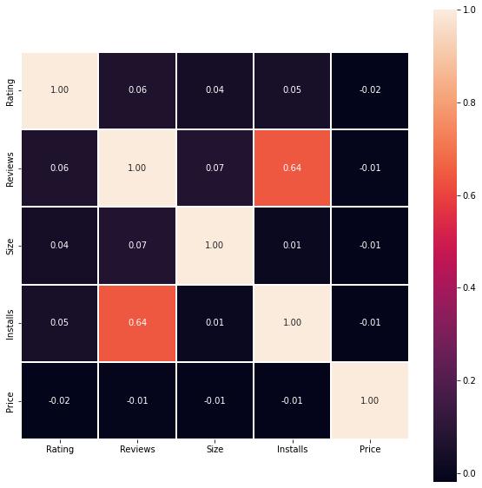
Correlation Heatmap
There is a direct correlation between Reviews and Installs
The Correlation is 0.64
Users tend to install apps with higher number of reviews in comparison to apps with fewer reviews

Slide 14
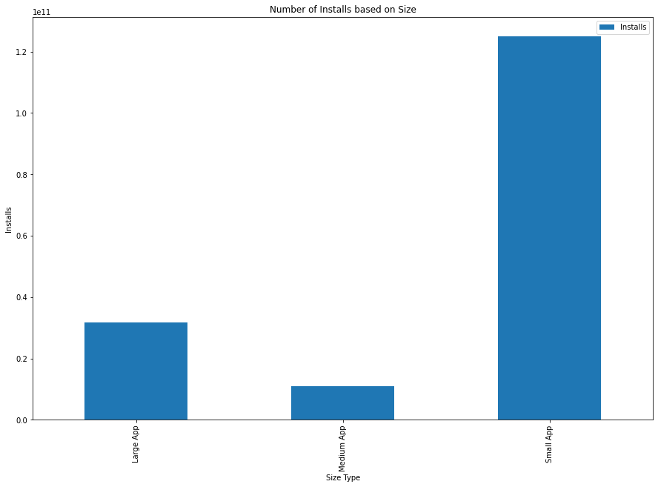
Installs and Size
Initially apps are categorized according to their size wherein:
Small: 0MB to 25MB(excluding)
Medium: 25MB to 50MB(excluding)
Large: more than 50MB(including)
It can be seen that Small apps have been installed the most
Larger apps are the second most installed type of apps with size more than 50MB

Slide 15
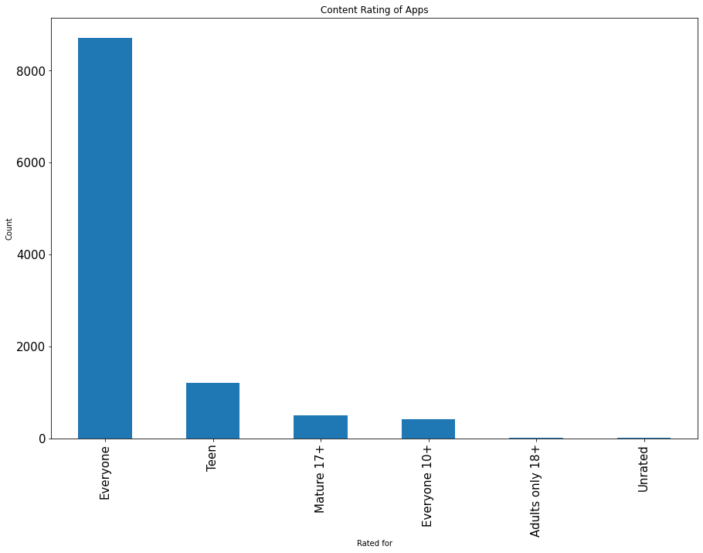
Content Rating and Apps
The given data set has highest number of apps rated for everyone followed by Teen
It can be noted that there are few unrated apps

Slide 16
Some more insights:
The Costliest app is I'm Rich - Trump Edition with price tag of 400$ and 3.6 star rating with more than 10,000 installs.
Free apps have been downloaded significantly higher compared to paid apps. There are 167,56,04,78,406 installs for Free apps in Total while paid apps have 7,29,56,081 downloads
Top 5 highly installed apps are: Subway Surfers, Facebook, Messenger – Text and Video Chat for Free, Google Drive, Google Drive
There are 274 apps with 5 star rating and top app with highest average user rating is "Ek Bander Ne Kholi Dukan" belonging to Family category and entertainment Genre with 10,000 plus downloads

Slide 17
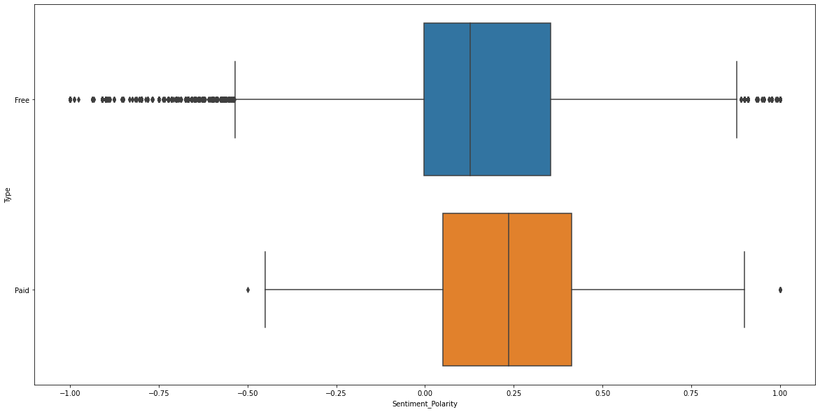
Sentiment Polarity Analysis
median sentiment polarity for free apps is about 0.15 implying slightly positive sentiment among users in general
median sentiment polarity for paid apps is about 0.23
Paid app users have reviewed the installed apps in more positive way than Free app users

Slide 18
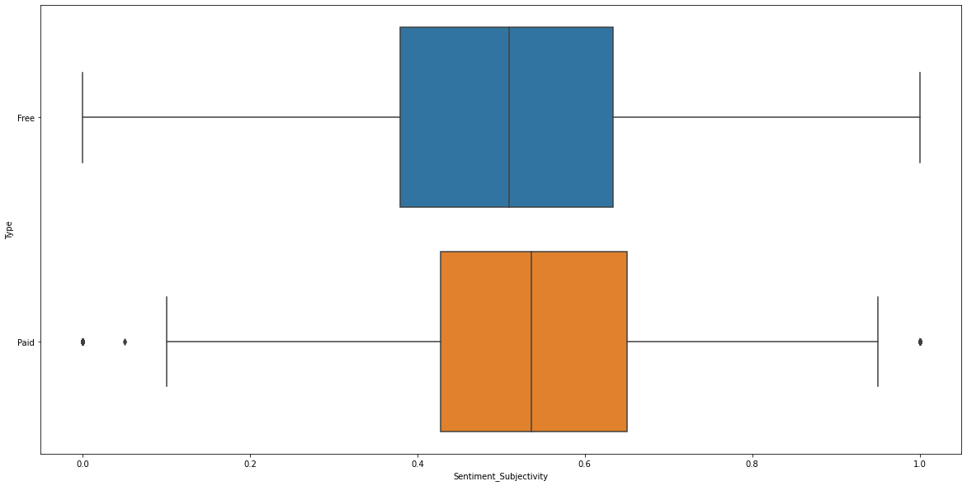
Distribution of apps based on Sentiment Subjectivity
median for Free apps is about 0.5 while median for paid apps is about 0.55
Relative to the paid app reviews, free app reviews are more objective in nature
There are extremely objective and subjective reviews in paid reviews

Slide 19
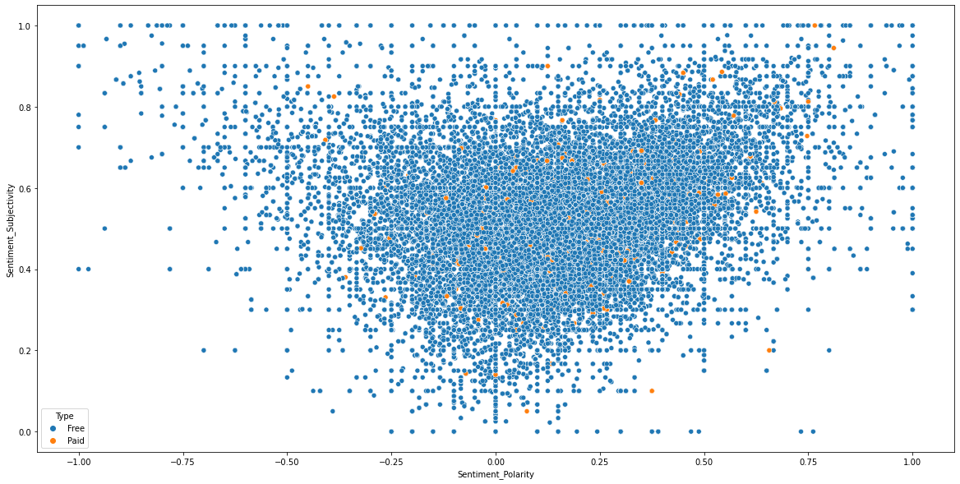
Apps, Sentiment Polarity and Subjectivity
It can be seen that more number of app reviews are subjective and positive in nature in comparison with other subjectivity and polarity parameters considered together.
Least number of app reviews are objective and negative type

Slide 20
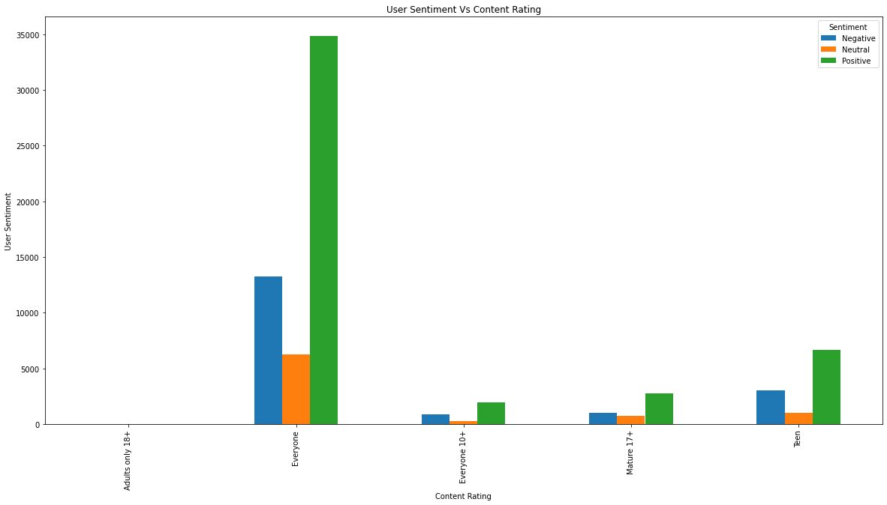
Content Rating and Type of Sentiment
Apps made for everyone have the highest number of reviews with either neutral or positive or negative sentiments

Slide 21
Thank You

